Slide 1


Slide 2
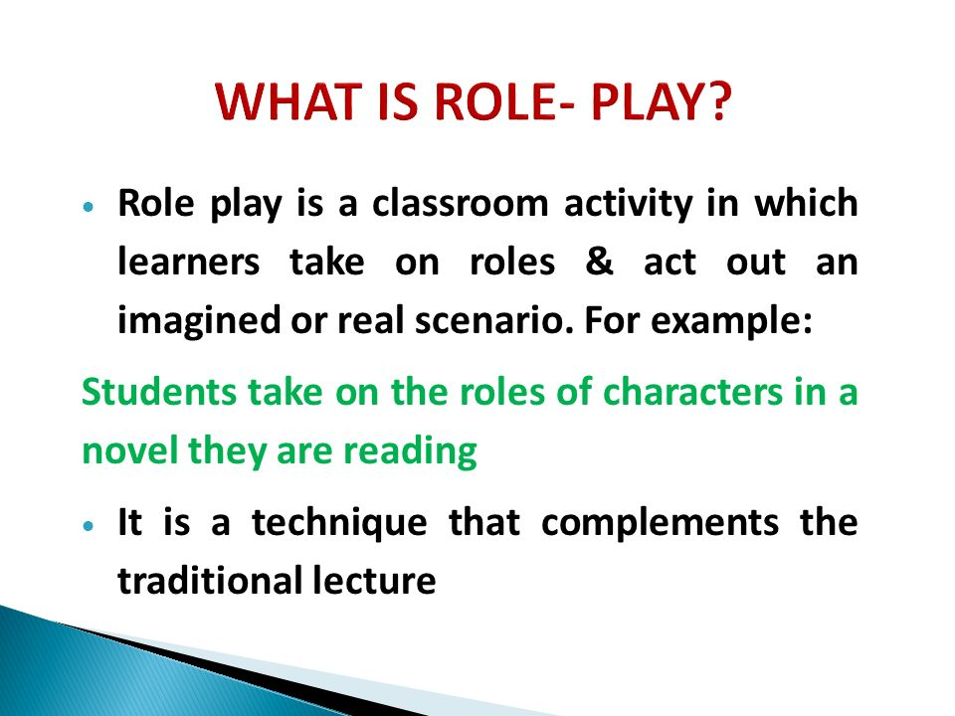

Slide 3
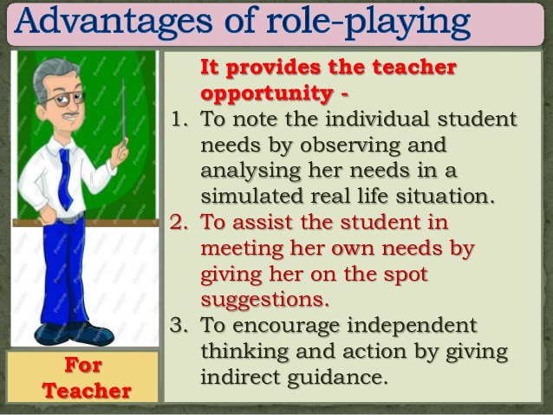

Slide 4
TOPICS FOR ROLE PLAY Ø A conversation between a teacher and a student Ø A Doctor dealing with an angry patient Ø Dealings between a shopkeeper and an angry customer Ø An interviewer and an interviewee Ø A manager handling a disruptive teammate Ø A Telephonic conversation Ø Arguments between two friends Ø A cabin crew staff dealing with a challenging passenger Ø A conversation between a travel agent and a client Ø A negotiation between a house-broker a tenant Ø A banker dealing with a customer Ø A coach training a sportsman Ø Booking a hotel room.. Ø Ordering food at a restaurant Ø A guest complaining the Manager of a hotel against an unfriendly staff Ø A guest complaining the Manager of a hotel regarding the poor food quality. Ø Convincing a village person on the importance of “Swachh Bharat”

Slide 5
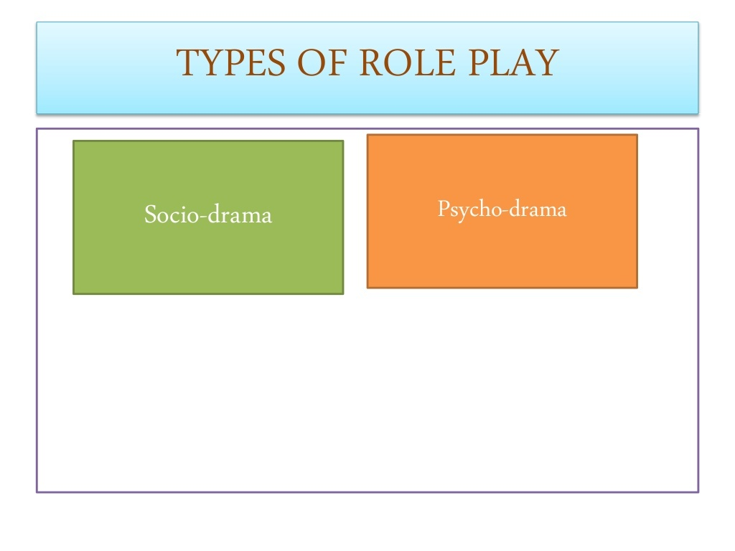

Slide 6
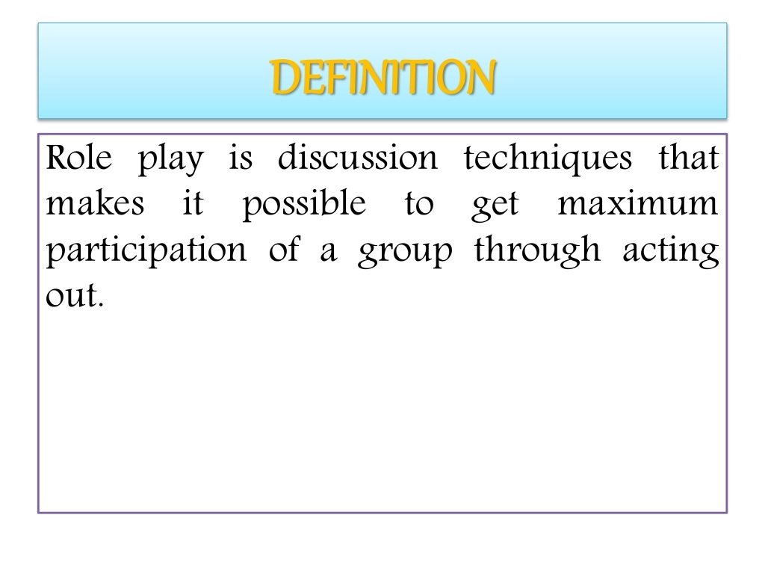

Slide 7
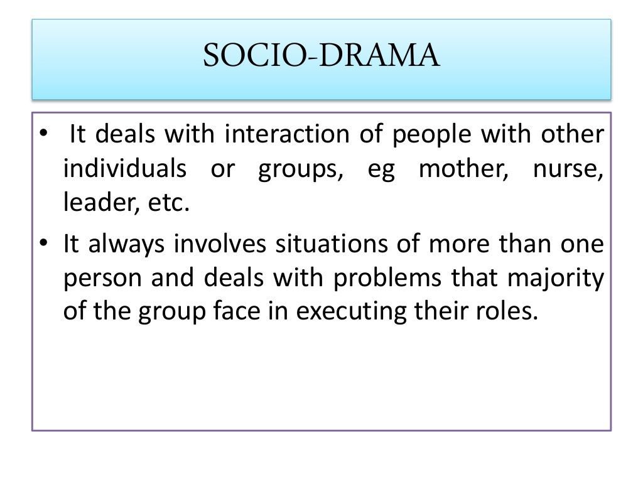

Slide 8
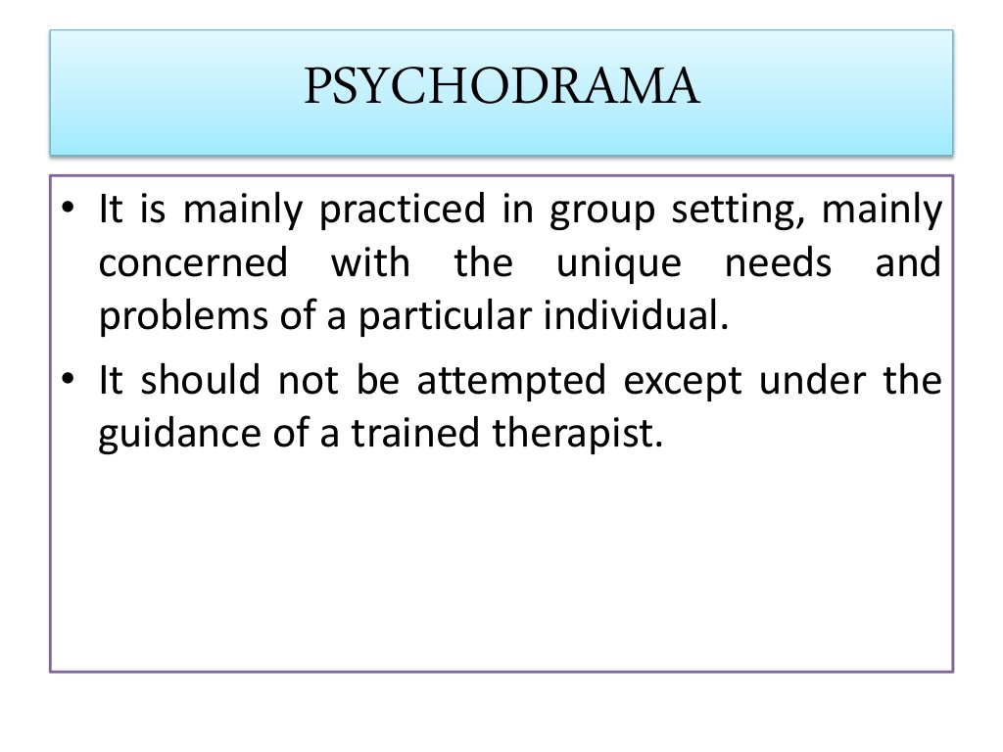

Slide 9
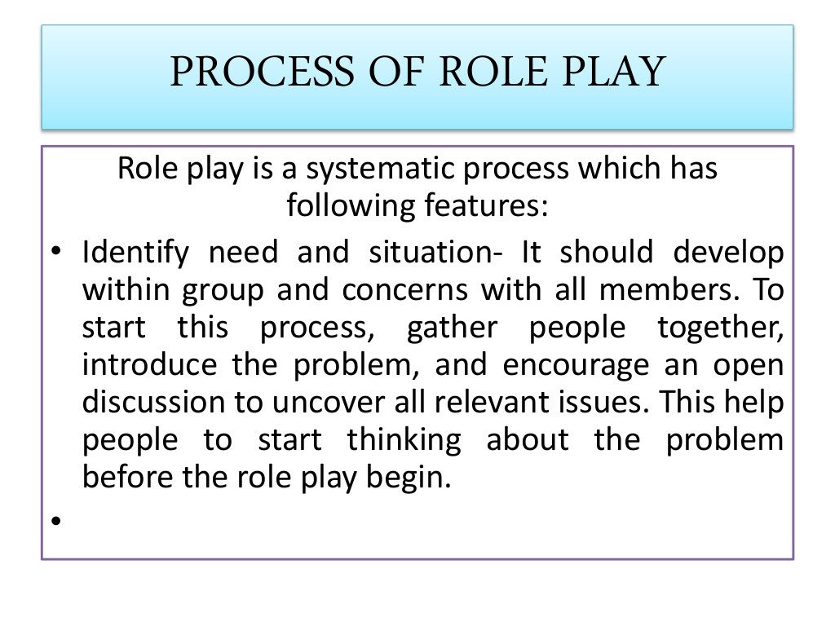

Slide 10
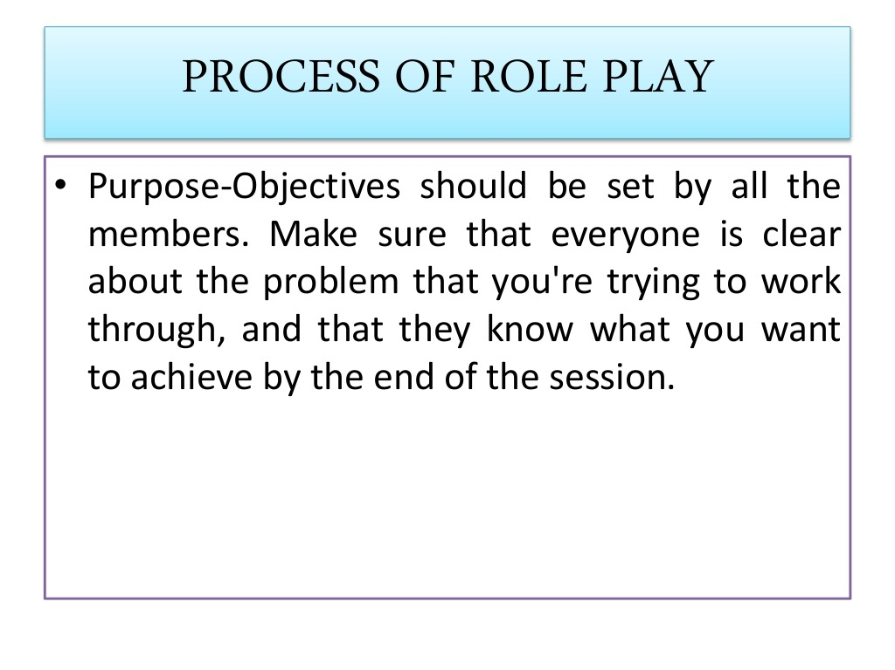

Slide 11
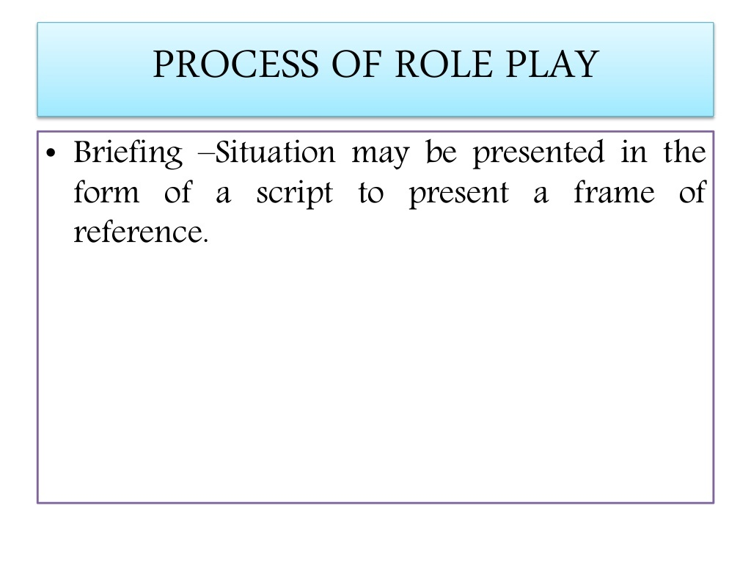

Slide 12
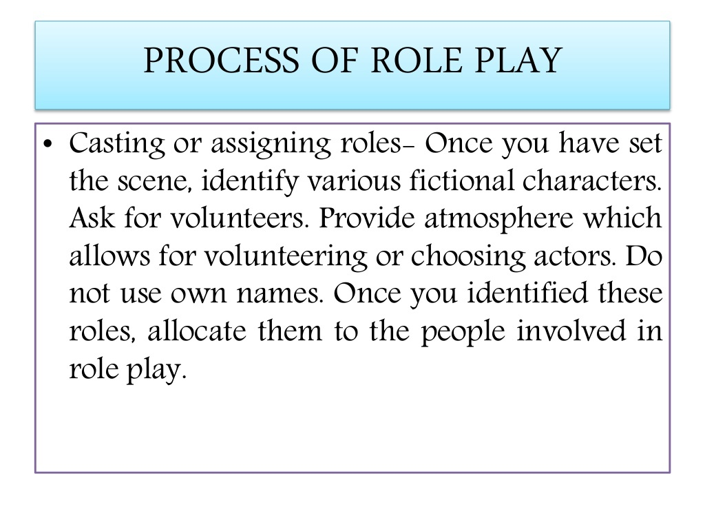

Slide 13
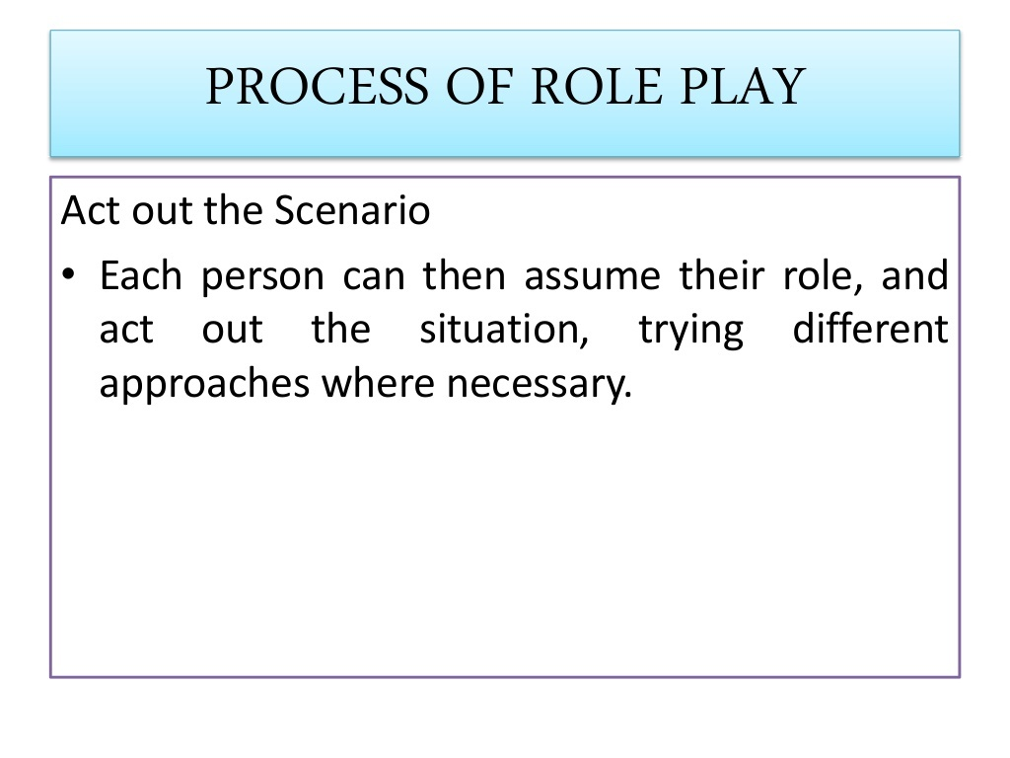

Slide 14
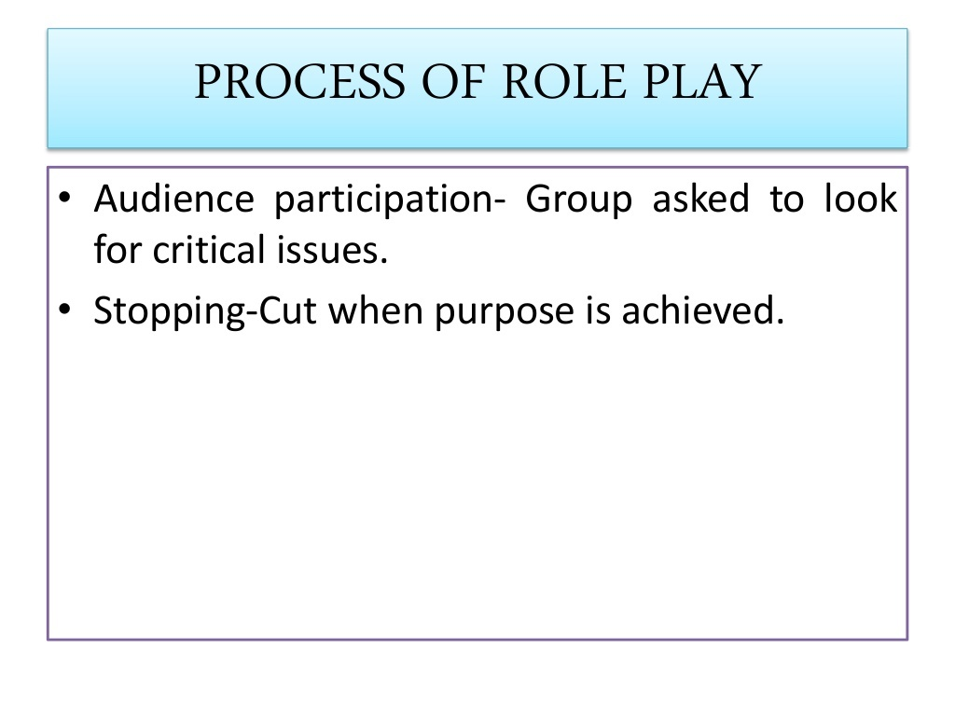

Slide 15
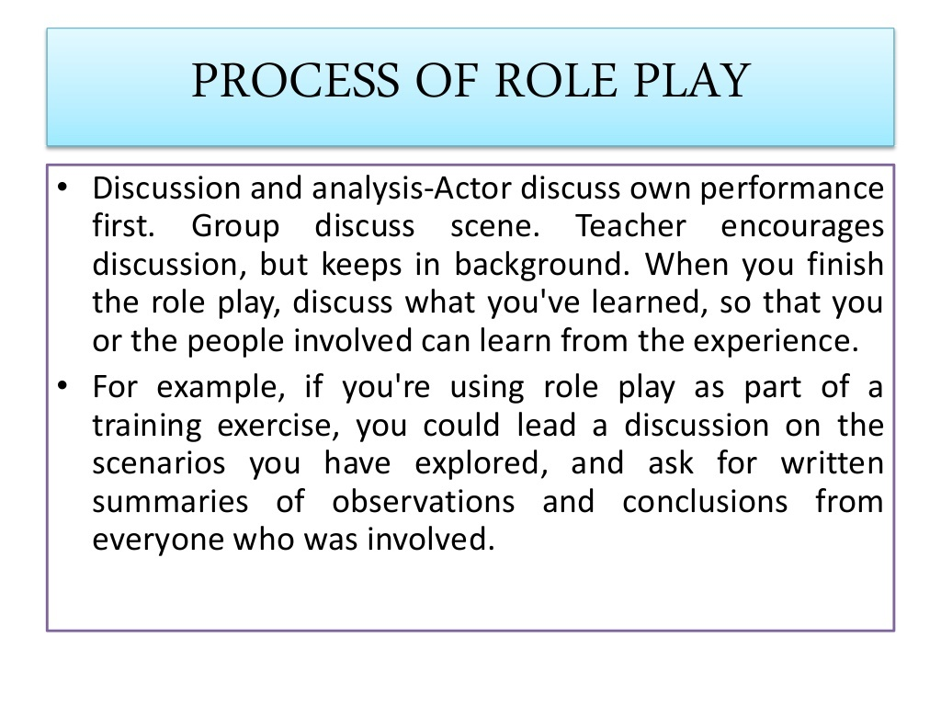

Slide 16
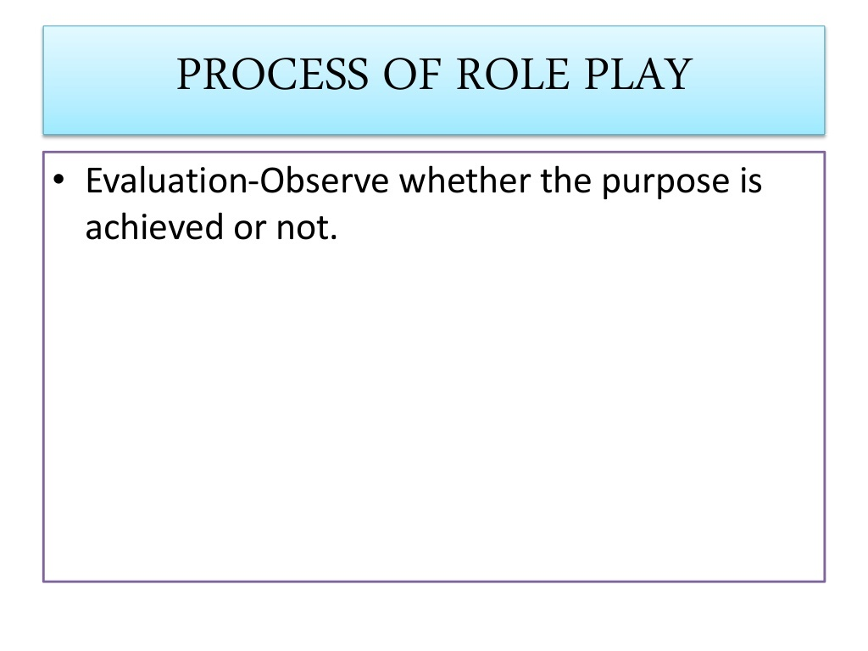

Slide 17
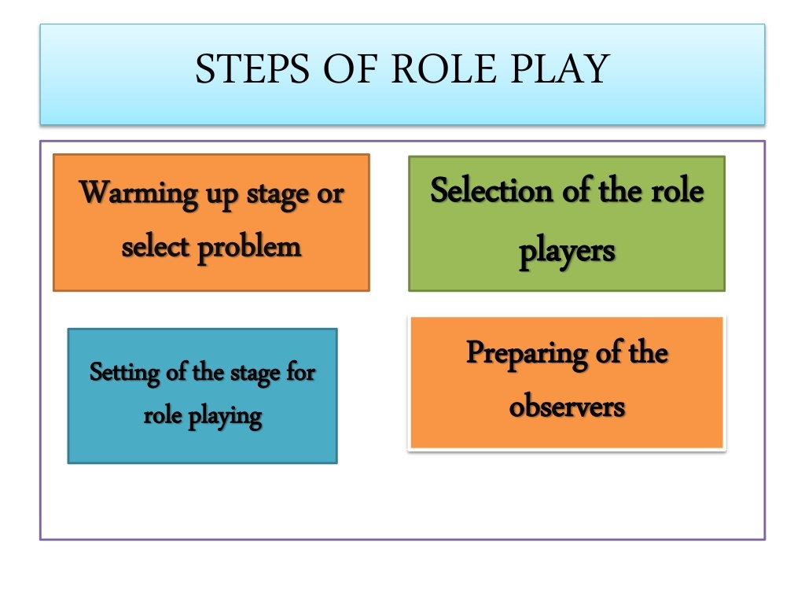

Slide 18
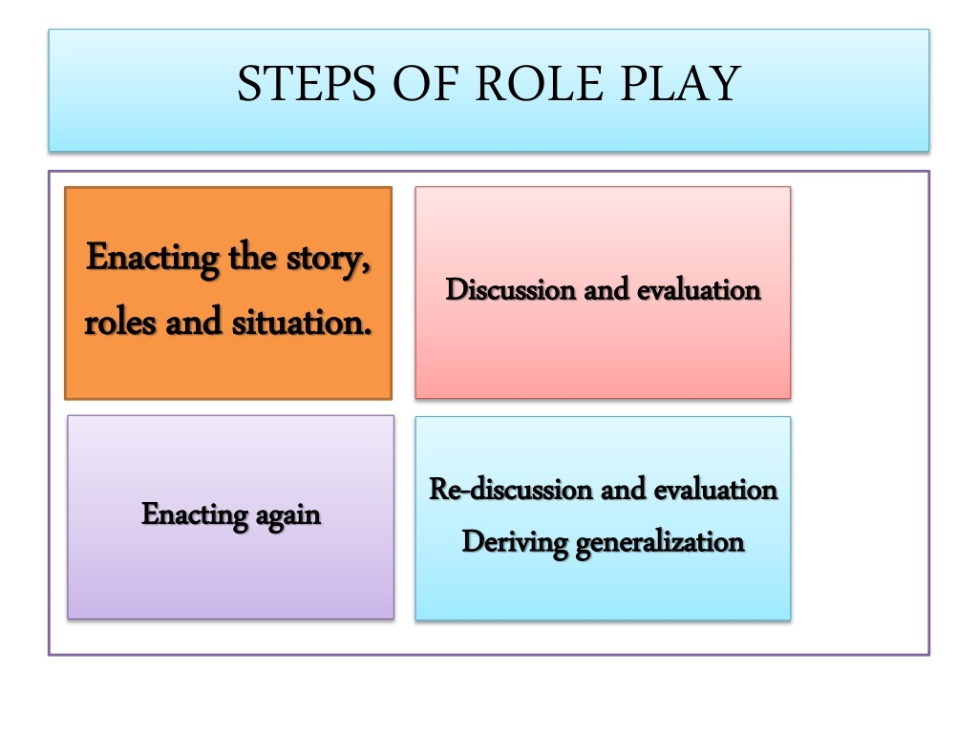

Slide 19
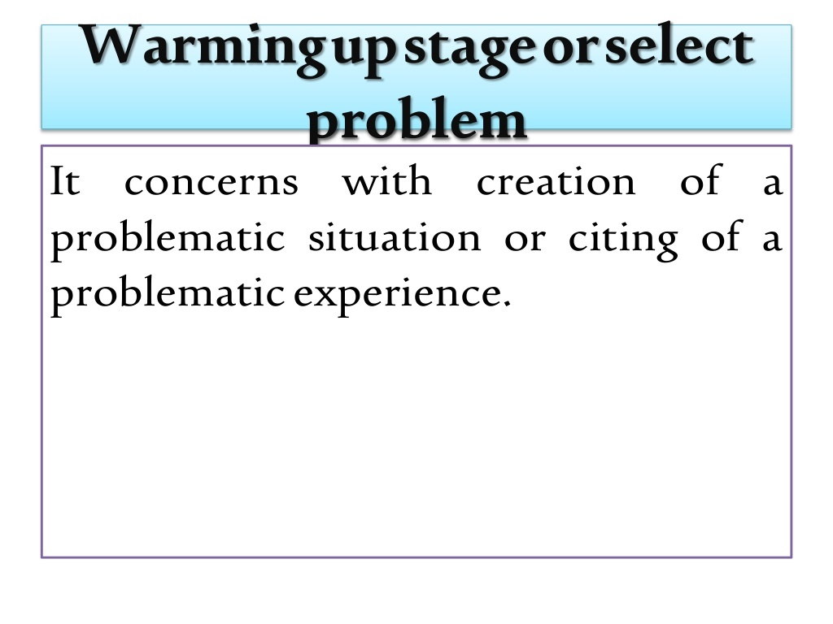

Slide 20
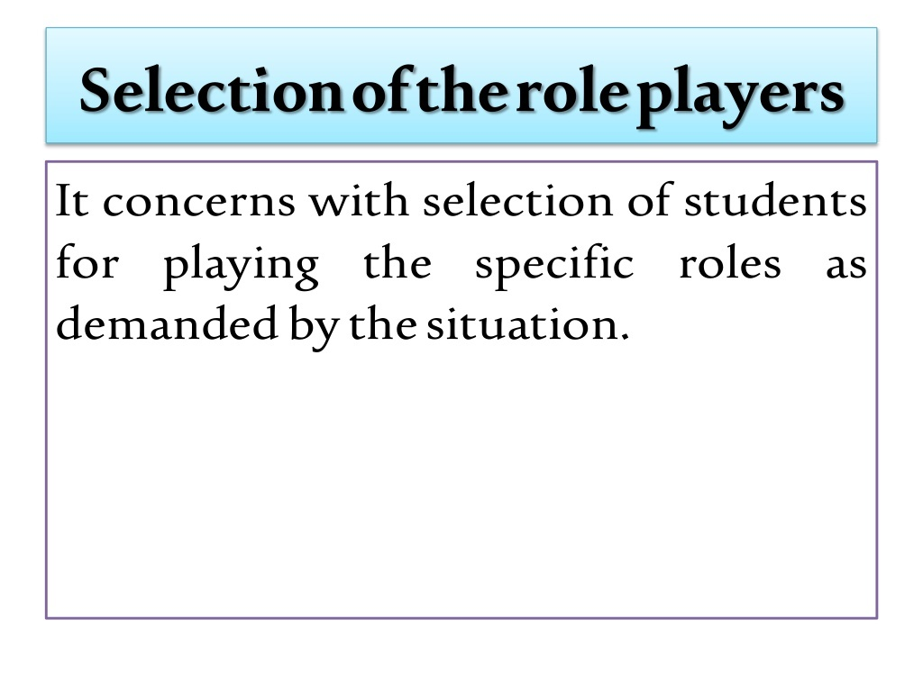

Slide 21
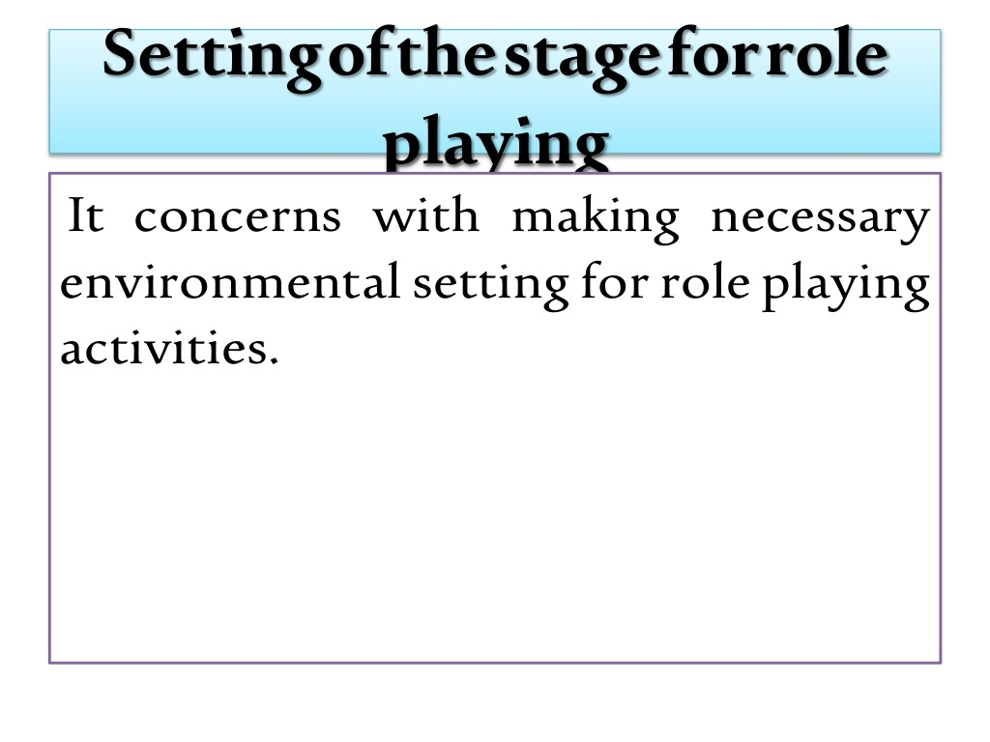

Slide 22
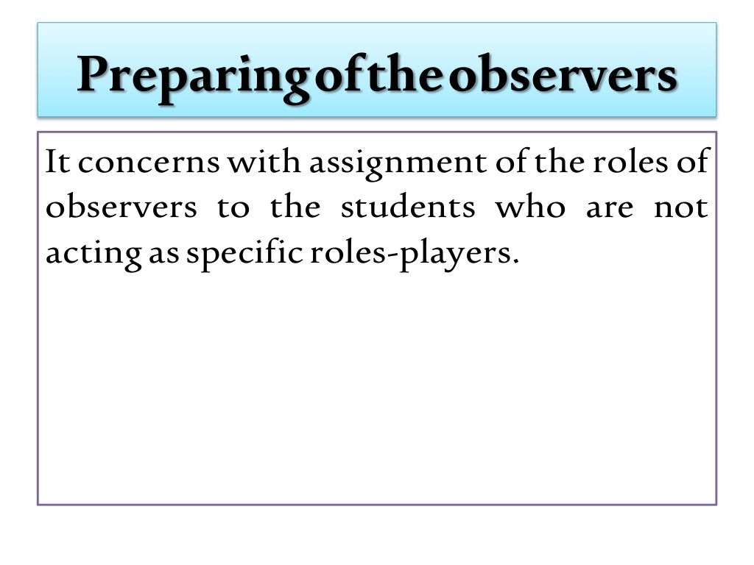

Slide 23
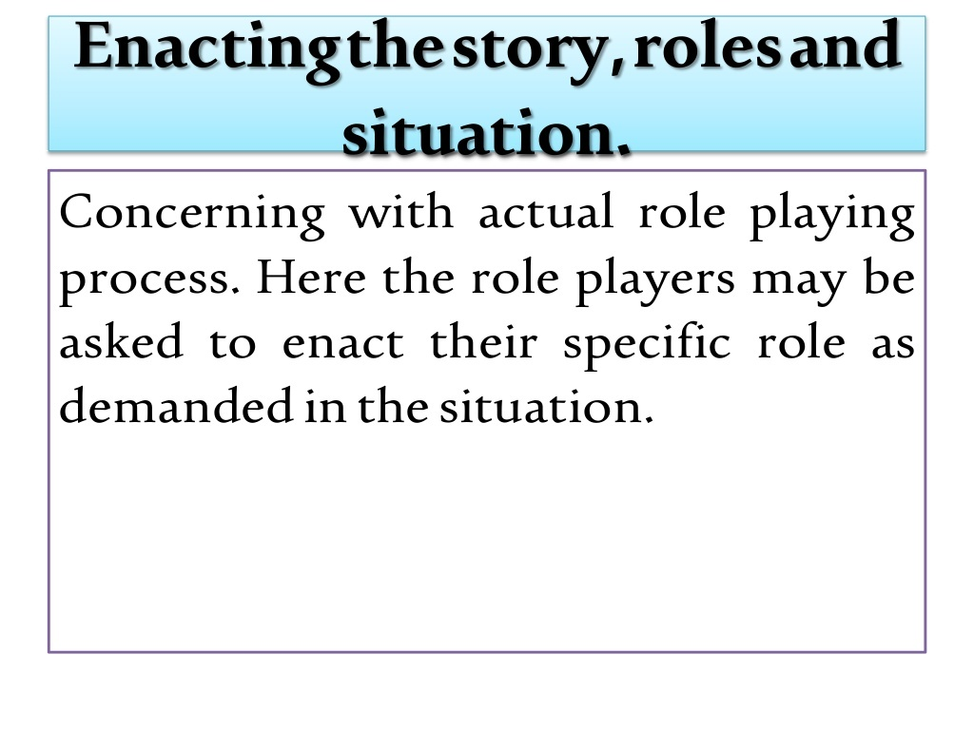

Slide 24
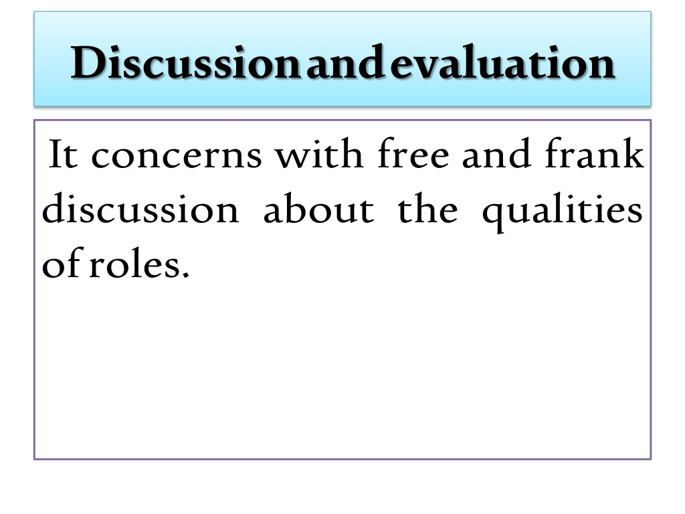

Slide 25
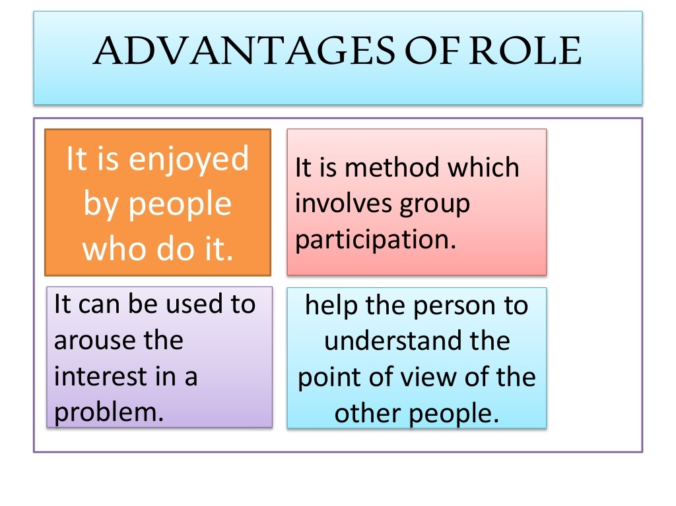

Slide 26
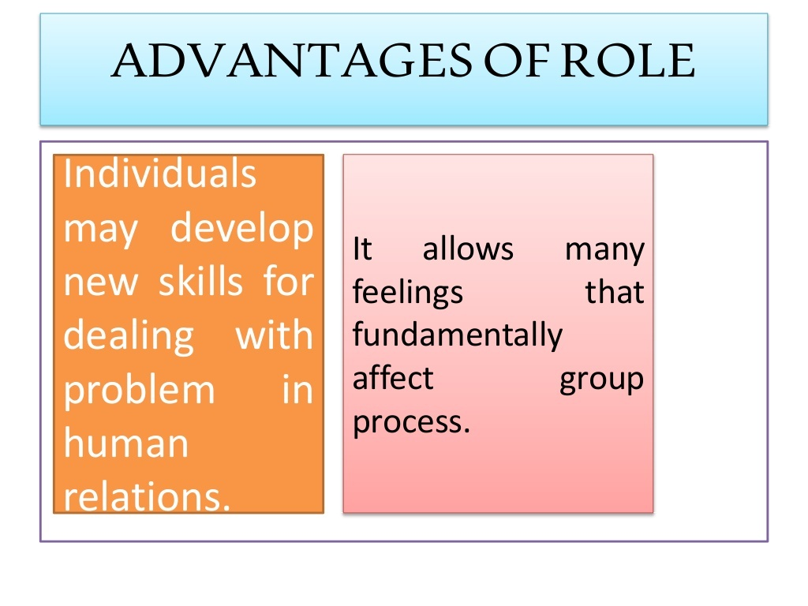

Slide 27
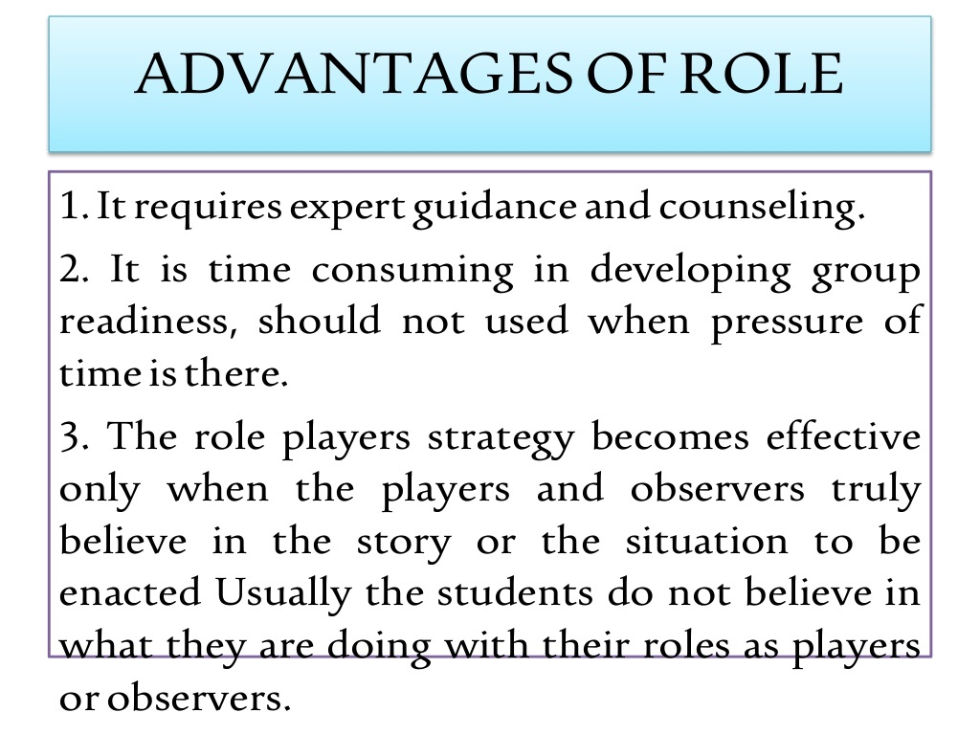

Slide 28
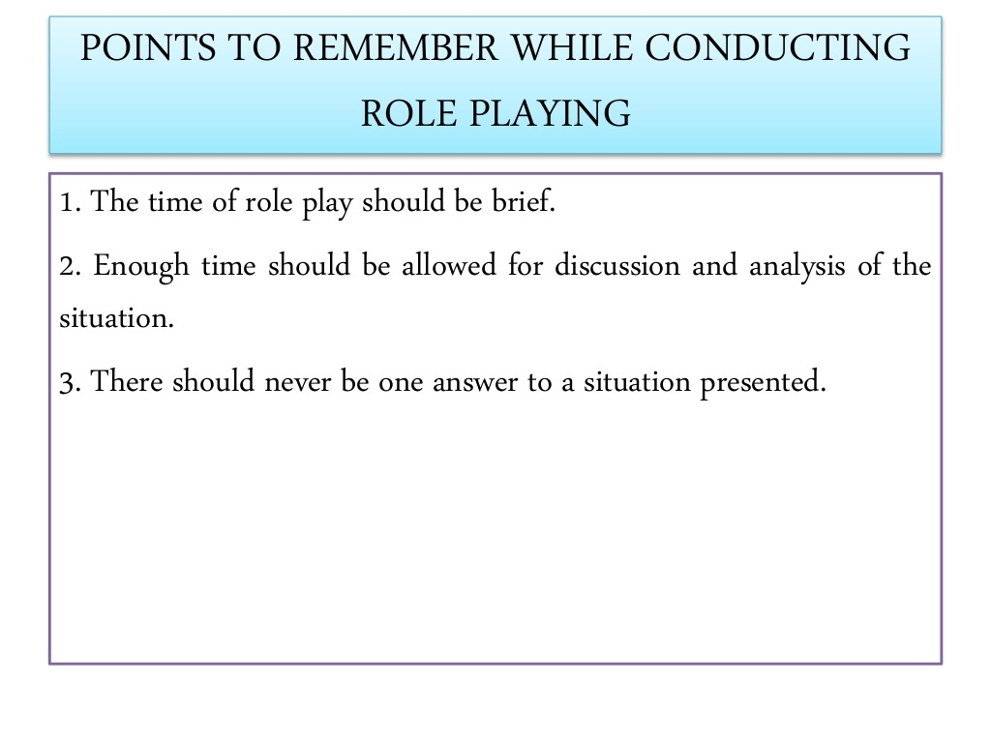

Slide 29



